Slide 1


An accessible, integrated database of 9 (and counting) fish surveys in the Bay-Delta
Sam Bashevkin (Delta Science Program)
Jeanette Clark (National Center for Ecological Analysis and Synthesis)

Slide 2

Data integration is time-intensive
Delta Juvenile Fish Monitoring Program
Smelt Larva Survey
Detailed examination of metadata
Interview PIs and survey staff
Code reproducible steps
Design integrated data structure
Suisun Marsh Fish Study
Bay Study
Summer Townet
20-mm Survey
Fall Midwater Trawl
Enhanced Delta Smelt Monitoring
Spring Kodiak Trawl

Slide 3



We* integrated 9 fish surveys so you don’t have to
Suisun Marsh Fish Study
Delta Juvenile Fish Monitoring Program
Enhanced Delta Smelt Monitoring
Smelt Larva Survey
Summer Townet
Fall Midwater Trawl
Spring Kodiak Trawl
20-mm Survey
Bay Study
*Additional contributors
Lara Mitchell
Shruti Khanna
Trinh Nguyen

Slide 4




Data integration process
Start with unmanipulated exported Access tables
Reproduce queries and data manipulations in R
Combine datasets without introducing biases
Build package that will be useful for future efforts
Fall Midwater Trawl
R data package
Bay Study
Suisun Marsh Fish Study

Slide 5

Variables included
Most environmental variables (temperature, conductivity, Secchi depth, etc.)
Sampling effort (tow area or tow volume)
Fish lengths
Adjusted length frequency
$F_{l,t,s}=T_{t,s}\frac{C_{l,t,s}}{M_{t,s}}$
Number of fish for each length, taxa and sample
Adjusted frequency for each length, taxa, and sample
Total number fish for each taxa and sample
Number of measured fish for each taxa and sample

Slide 6
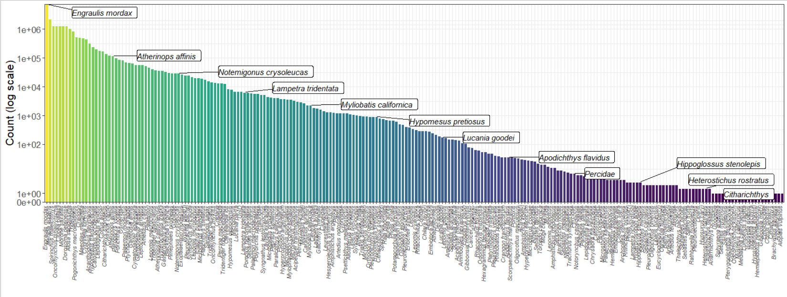
224 taxa and 22,880,411 total fish

Slide 7


About the database
This dataset is quite large! >40 million rows, and 22 variables
Currently, it is split into two primary data tables
Fish: length, count, taxa
Sample information: station, lat, lon, environmental variables, tow information
filter()
left_join()
group_by()
summarize()

Slide 8
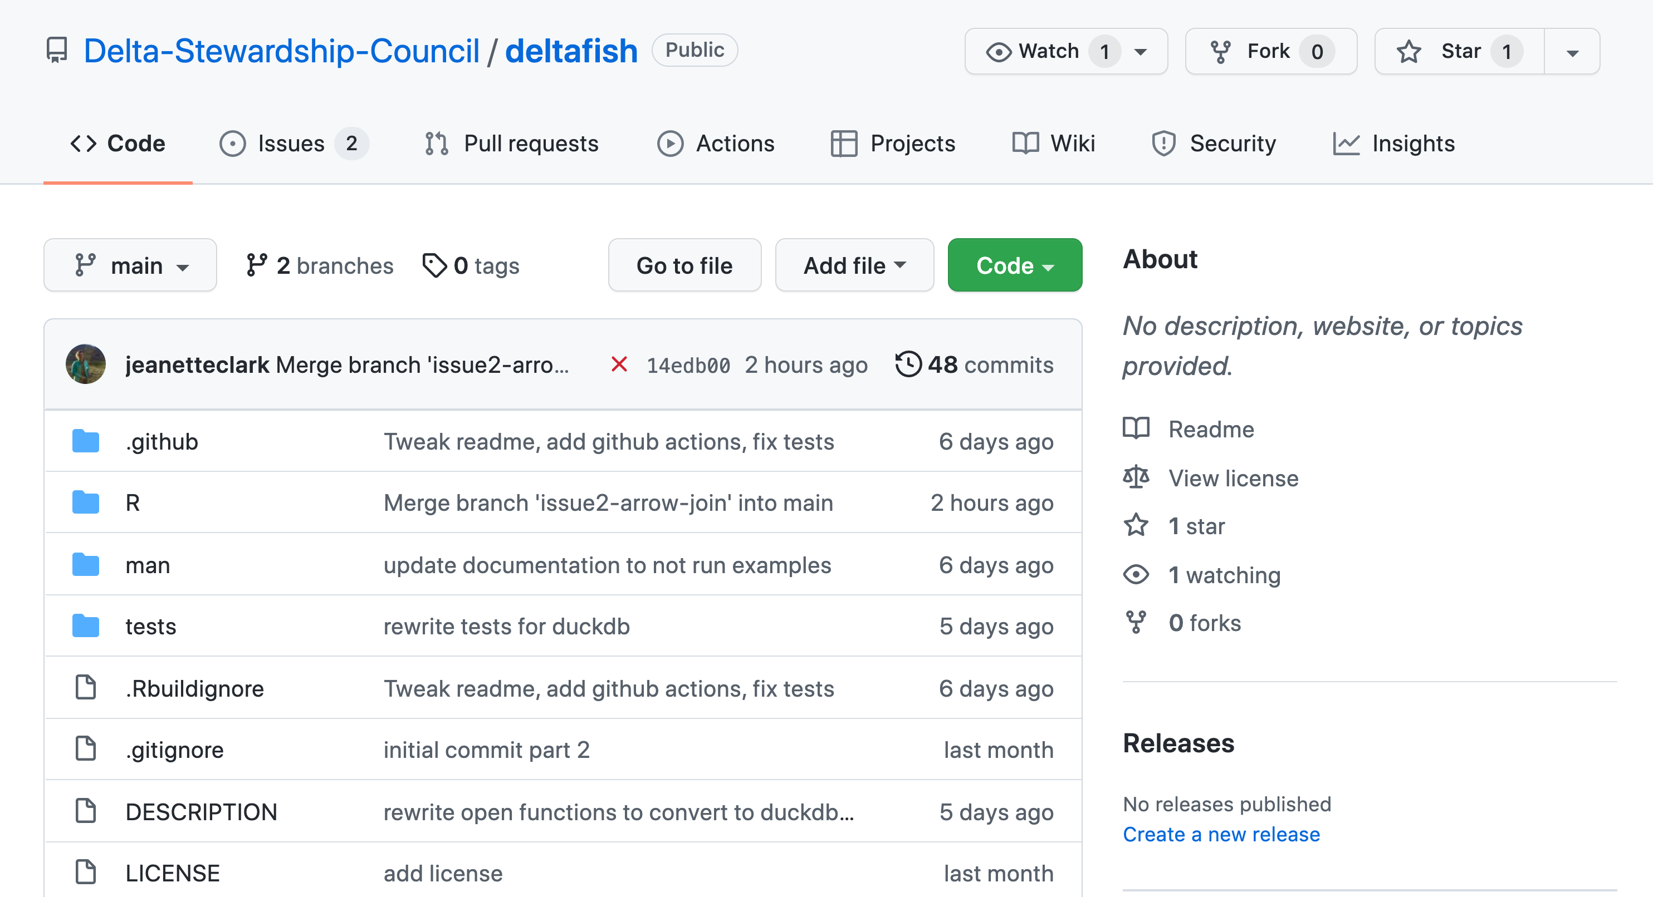
R package
R package accesses archived data
Online for transparency
Archived for reproducibility
Local cache and special functions for efficiency

Slide 9
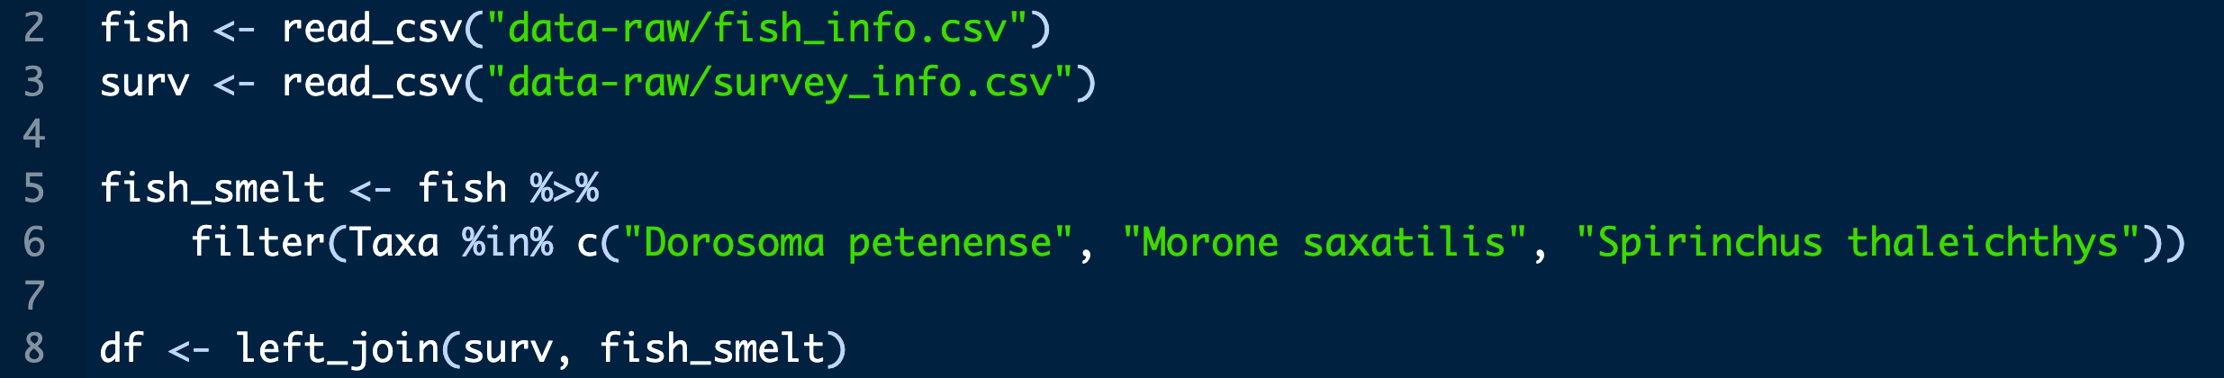
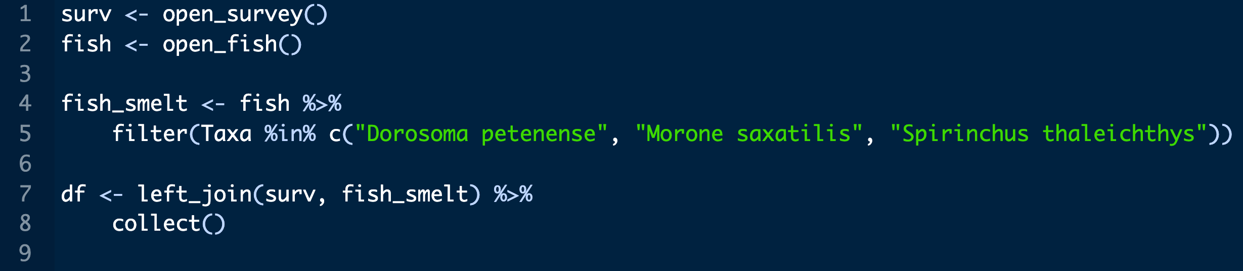
Working with the data – a comparison
Usual methods, with local csvs
Duration: 19 seconds
Memory required: 1.73 GB
Using the deltafish package
Duration: 11.1 seconds
Memory required: 180 MB

Slide 10
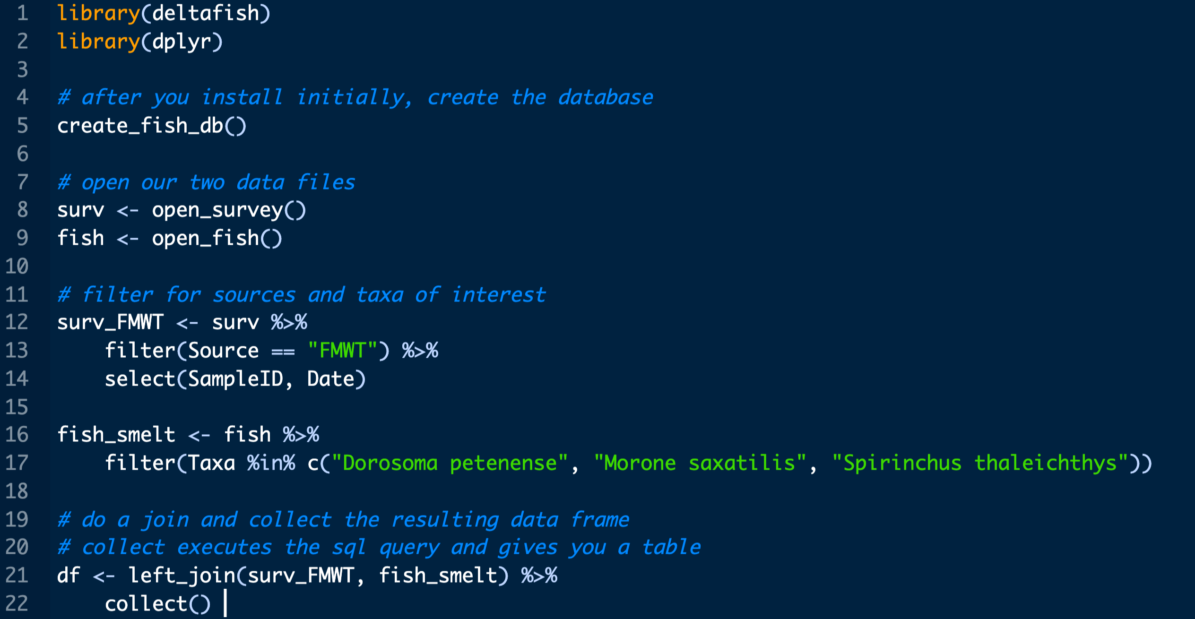
How it works

Slide 11
Limitations
Not all `dplyr` verbs are supported before you run `collect()`
Collecting the whole dataset is still very slow
Still in development!

Slide 12
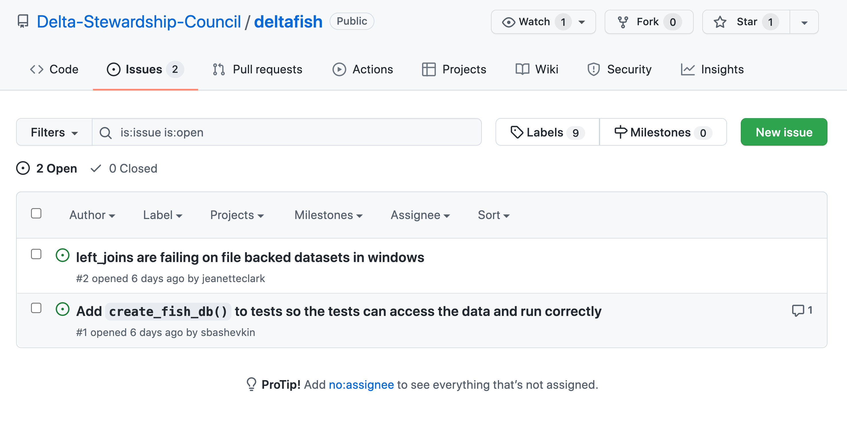
Next steps
More helper functions
Version checking
Update the local cache if new data are available
Fixing bugs, refining tests

Slide 13
Acknowledgements
Lara Mitchell
Shruti Khanna
Trinh Nguyen
Brian Mahardja
IEP long-term monitoring review team
IEP monitoring surveys

Slide 14
Questions for you
How would you use this?
What would you use it for?
Would you be comfortable accessing the database via R or would you prefer some other access mechanism?

